Slide 1
BERT
Bidirectional Encoder Representations from Transformers
Reza Marzban

Slide 2
Interesting Facts
BERT is based on the Transformer architecture.
It is pre-trained on a large corpus of unlabeled text including the entire Wikipedia(2,500 million words) and Book Corpus (800 million words)
Pre-training step is half the magic behind BERT’s success
deeply Bidirectional

Slide 3
2-step process:
Train a language model on a large unlabelled text corpus (unsupervised)
Fine-tune this large model to specific NLP tasks to utilize the large repository of knowledge this model has gained (supervised)

Slide 4
BERT’s Architecture
BERT Base: 12 layers (transformer blocks), 12 attention heads, and 110 million parameters
BERT Large: 24 layers (transformer blocks), 16 attention heads and, 340 million parameters

Slide 5
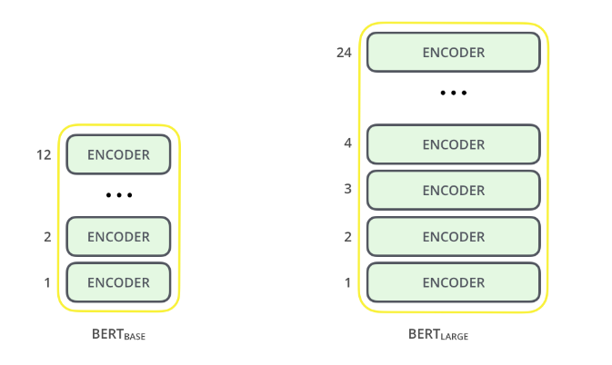
BERT’s Architecture

Slide 6
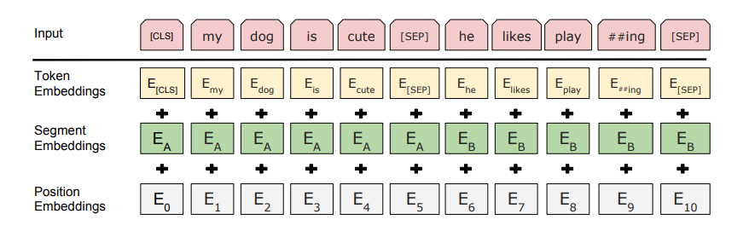
Text Preprocessing
Token Embeddings: Famous embedding leaned for each token (word), a.k.a. Word2Vec Embedding.
Segment Embeddings: distinguish between different sentences (uses {SEP} token)
Position Embeddings: keep track of sequence of each word to overcome its limitation in comparison to RNN or LSTM.

Slide 7
Pre-training Tasks
BERT is pre-trained on two NLP tasks:
Masked Language Modeling
Next Sentence Prediction

Slide 8
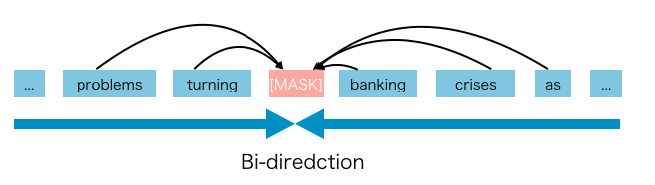
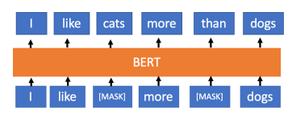
Masked Language Modeling
15% of the words are randomly masked:
80% of the time the words were replaced with the masked token [MASK].
10% of the time the words were replaced with random words.
10% of the time the words were left unchanged.

Slide 9
Next Sentence Prediction
The task is simple. Given two sentences – A and B, is B the actual next sentence that comes after A in the corpus, or just a random sentence?
Understands the relations of sentences.
Binary Classification.
For 50% of the pairs, the second sentence would actually be the next sentence to the first sentence
For the remaining 50% of the pairs, the second sentence would be a random sentence from the corpus
The labels for the first case would be ‘IsNext’ and ‘NotNext’ for the second case

Slide 10
Fine Tuning
4 main Categories:
Single Sentence Classification
Sentence Pair Classification
Tagging Tasks (Labeling)
Question Answering (Sequence to sequence)

Slide 11
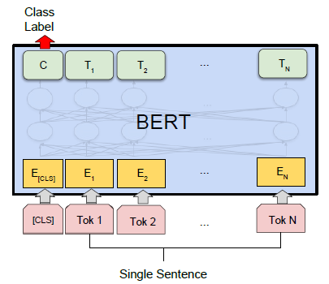
Fine Tuning
Single Sentence Classification

Slide 12
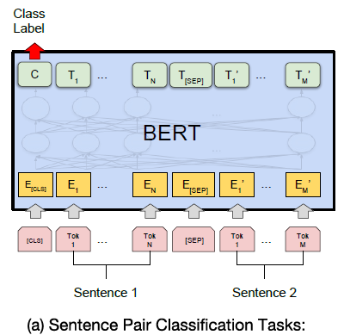
Fine Tuning
Sentence Pair Classification

Slide 13
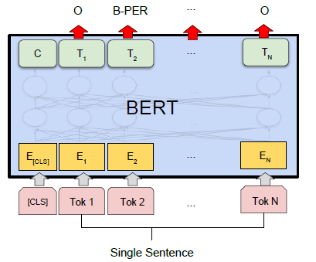
Fine Tuning
Tagging Tasks (Labeling)

Slide 14
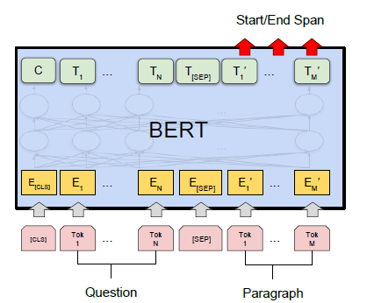
Fine Tuning
Question Answering (Sequence to sequence)

Slide 15
Advantages
Much better Accuracy than traditional Deep Learning architectures like RNN, LSTM, …
Uses Transfer Learning so by having a pre-trained model, you can reach high accuracy after a few epochs.
It has trained for many popular languages.

Slide 16
Disadvantages
Pre-Processing is too long. (Takes a few weeks on various TPUs)
Number of Parameters are too high.
There is still a limitation on the number of words / Tokens in the input.

